Slide 1
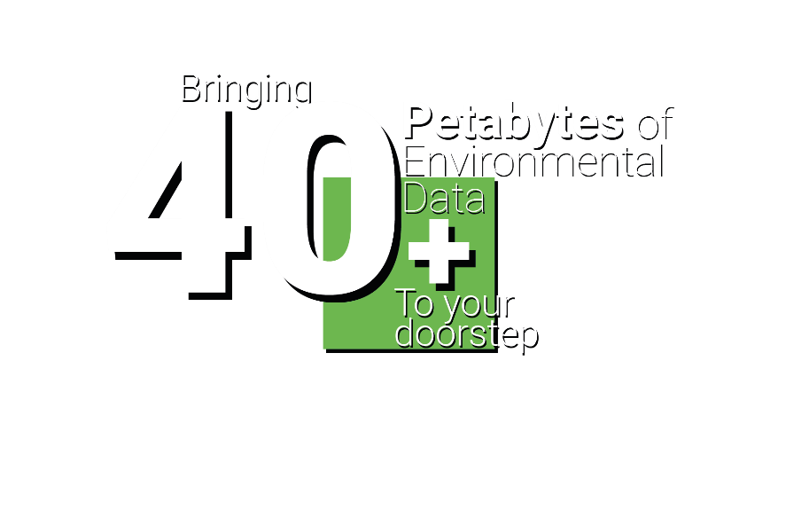
Leveraging data science to support policymakers to make evidence-based decisions at national, regional and local scales
DIGITAL SOLUTIONS HUB
Richard Kingston
Prof of Urban Planning & Geographic Information Science,
The University of Manchester
digital-solutions.uk
@nercdsh
Notes:
Start off with the background to DSH’s overall aim.
Our approach – putting users first and how we gather their requirements.
The focus a bit on how do you wrangle over 40 petabytes of data into a decision support system.
Some early use cases.
What next and questions.

Slide 2
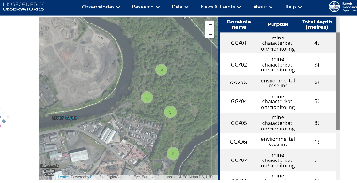
NERC Digital Solutions Programme
5 year £8m investment to build a UKRI ‘national facility’ – the Digital Solutions Hub – during phase 1
NERC’s core focus is to work closely with stakeholders across the public / third sector and industry
plus those of you who are not environmental scientists in academia
making NERC’s 40+ PBs data more discoverable to non-academic users
to make better use of their data from the 5 data centres
connecting with social, economic, health and other environmental data across the whole of the UK
integrated with JASMIN for analytics and modelling
Post 2025 – phase 2 funding
Notes:
The main focus of Digital Solutions Programme is to build a hub that provides users with what they want and need, rather than what we think they need.

Slide 3
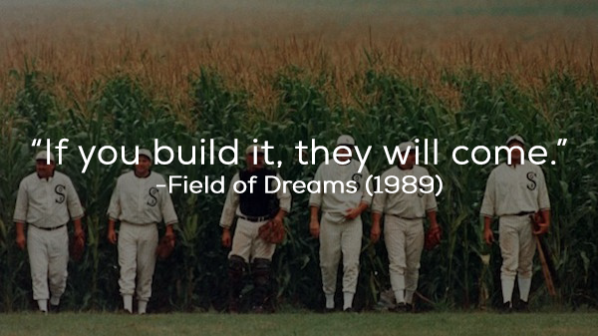
Overall approach
Build it and they will come.
No, no, no.
So, you spent 4 years building this thing, it’s great it can do A, B and C but we also want it to do X, Y and Z !

Slide 4
(previously PHE)
Notes:
This only captures a fraction of our engaged partners.

Slide 5
User-centric digital solution
Defra
Users
DoT
Public sector
Commercial
DLUHC
Academic
3rd sector
DHSC
Citizen science
EA
Will allow users to run computationally intensive analysis
What-If? modelling
Use other’s models or run your own
We will evolve in to a UKRI ‘national facility’ so not disappearing after the initial funding*
SEPA
User defined
data.gov.uk APIs
ONS
Primary data
SNH
NHS Digital
Use cases
JASMIN
BODC
Cloud Azure / AWS
ADS
UoM compute services
CEDA
NERC EDS
BGS
Secure data services
EIDC
Digital Env.
DCS
NGDC
DAFNI
HSE
Met Office / UKCP
UKCRIC
GAD
OS
* Assuming we don’t mess this up!

Slide 6
User Needs Mapping Approach

Slide 7
User Needs to Design Decisions
Data Collection
Questions
Analysis
Output
User Needs Workshops
(Oct 22 – Jan 23)
Who are the users?
ODM report
Personas
What (env.) data & tools do they use?
Network Analysis
Data & tools users need
How do they use (env.) data in their workflow?
ODM report
User Journeys / Scenarios
How can DSH improve their workflow?
Requirements Elicitation
(Oct – Nov 23)
Design Requirements Catalogue

Slide 8
The Landscape Users Operate in
Data is held in lots of places.
Data is not always held in formats, or on systems, that make it easy to search for.
It’s not always obvious what the purpose of different platforms is, and the variety of data they contain.
It is hard to keep up with the ‘sheer range’ of these.
Some platforms are ‘clunky’ to learn and use with multiple clicks needed to get at data, or arduous registration processes.

Slide 9
Key Requirements
Users need sufficient access to the data to quality assure it, clean it and transform it into suitable format.
Reviewing a sample of a dataset may help determine its suitability in an easier way.
Users need to be able to keep track of work and resources they have done on datasets.
Users are keen to avoid duplication of effort – through sharing work they’ve done on datasets and accessing the work others have done.
A way of applying suitable analysis software to data.
Allow users to combine/link their own data with other data they access from DSH as part of analysis.
Notes:
Report about to be published with all the details

Slide 10
User Journey
Prioritise
Understand
Verify
Access
Test
Present
Iterate
Gather
Comprehend
Find
Promote
Process
Manage
Analyse
DEFINE
GET
ANALYSE
SHOWCASE
MANAGE

Slide 11
Archetypes (personas)
The
The
Analyst
Investigator
Analysts monitoring the environment
Analysts answering questions with data
The
The Data
Author
Specialist
Authors of monitoring frameworks
GIS specialists and data support
The Data
The Data
Leader
Steward
Data leaders in organisations
Focusing on data quality and sharing

Slide 12
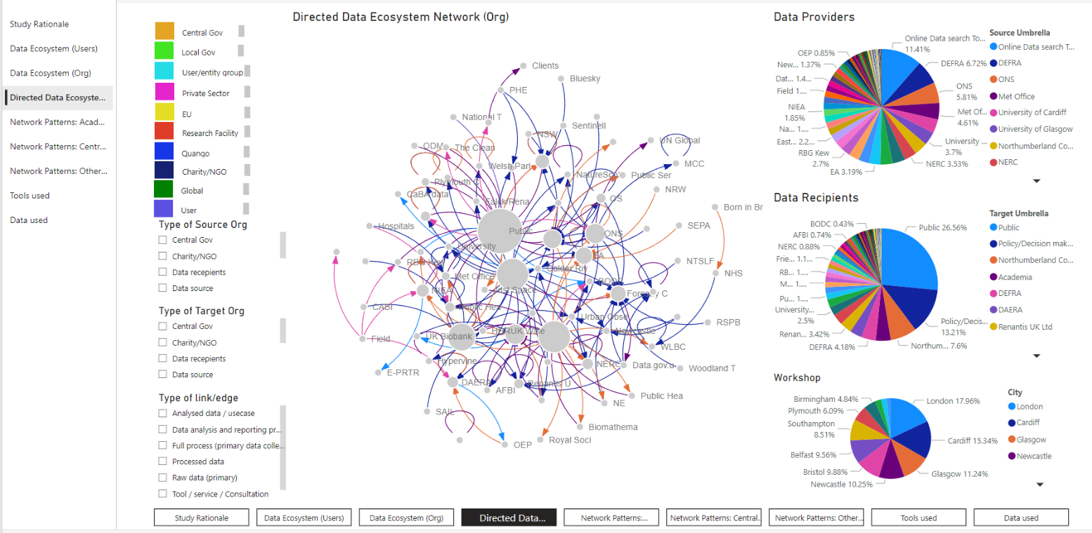
Understanding how users use Data
INTERACTIVE DATASET
273 data transactions
100 users
84 organisations

Slide 13
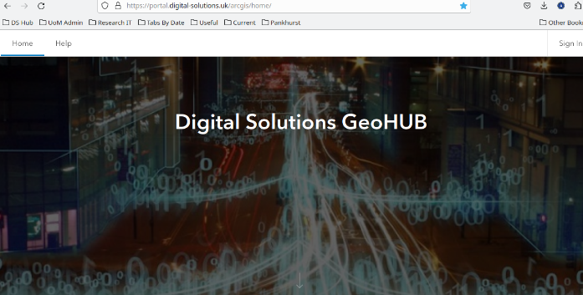
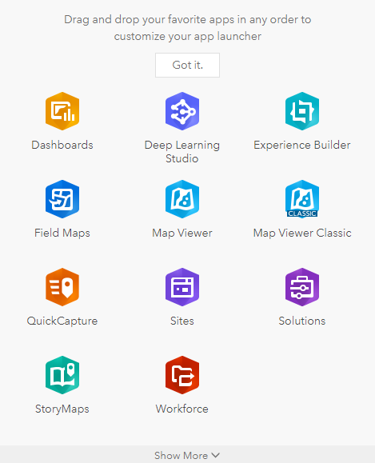
Next steps with our users
Following up with workshop attendees (interviews and focus groups).
Developing detailed use cases.
Continue to build the Hub (on premise at UoM and on JASMIN) based partly on Esri’s ArcGIS Enterprise stack.
Provide early access to workshop attendees and other (you?) interested stakeholders.
Develop analytical tools for users.
A full report on the user engagement workshops is published on our website
Sign up for our newsletter to keep up to date via our website.

Slide 14
Any questions so far…?
Next focus on how do you wrangle over 40 petabytes of data into a decision support system.
Some early use cases.

Slide 15
So, how do you wrangle over 40 petabytes of data
F1. (Meta)data are assigned a globally unique and persistent identifier
F2. Data are described with rich metadata (defined by R1 below)
F3. Metadata clearly and explicitly include the identifier of the data they describe
F4. (Meta)data are registered or indexed in a searchable resource
A1. (Meta)data are retrievable by their identifier using a standardised communications protocol
A1.1 The protocol is open, free, and universally implementable
A1.2 The protocol allows for an authentication and authorisation procedure, where necessary
A2. Metadata are accessible, even when the data are no longer available
I1. (Meta)data use a formal, accessible, shared, and broadly applicable language for knowledge representation.
I2. (Meta)data use vocabularies that follow FAIR principles
I3. (Meta)data include qualified references to other (meta)data
R1.1. (Meta)data are released with a clear and accessible data usage license
R1.2. (Meta)data are associated with detailed provenance
R1.3. (Meta)data meet domain-relevant community standards
FAIR Principles
Findable
Accessible
Interoperable
Reusable
https://www.go-fair.org/fair-principles/

Slide 16
A challenge is knowing what data NERC has
Where will be the hottest place in the UK in 2030?

Slide 17
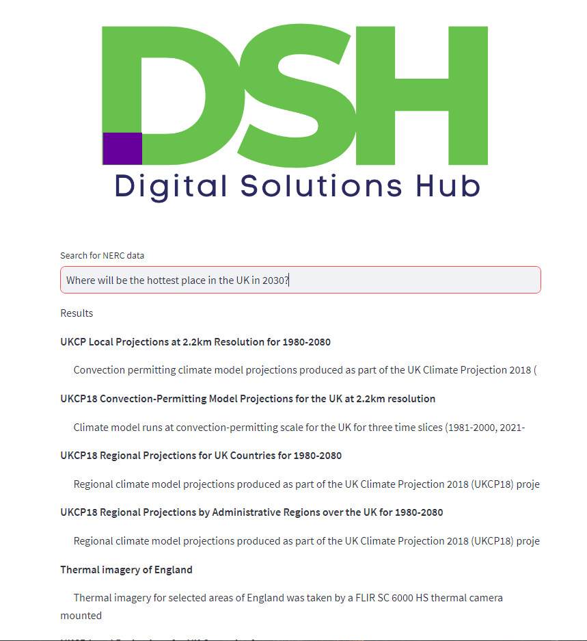
Uses google BERT model
Our approach searches the meta-data records and now provides a list of relevant datasets to help answer the question.
Next step is to allow user to visualise the data.
Using a Large Language Model (LLM) we have trained it on all the NERC meta-data records.
When we ask the same question

Slide 18
The DSH is not just a data portal
It will run on JASMIN – NERC’s supercomputer in Harwell.
Vast majority of the data is spatial.
As well as the NERC data we are integrating other environmental, social, economic and health data.
Allow users to find and explore data
Provide a range of exemplar use cases to show the art of the possible
Climate Just (repurposing from existing tools)
Britain Breathing (repurposing from existing tools)
air pollution and health (NHS, Met Office and Defra)
housing and environmental constraints (DLUHC and Geospatial Commission)
flooding from rivers, tidal surges, sea level rise etc. (Defra, EA, SEPA, NRW, GAD, LAs).
Heat stress – reducing the impact of the urban heat island (DLUHC, DoT, Defra, EA, LAs)

Slide 19
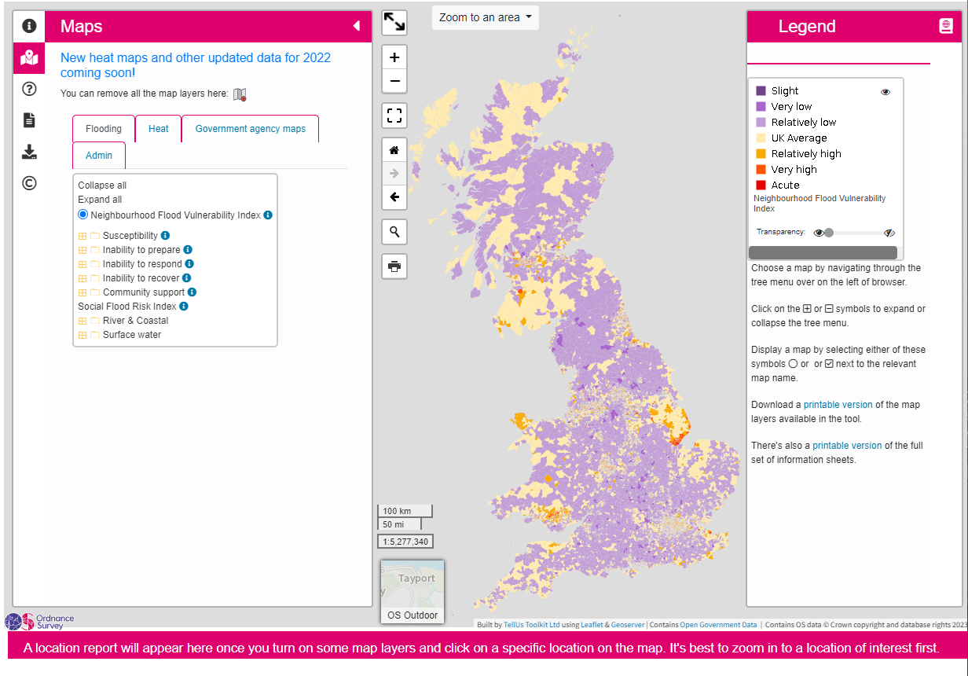
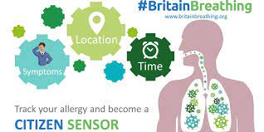
Repurposing existing tools
https://climatejust.org.uk/

Slide 20
Responding to user needs
Developing a set of POCs
Deliberately using a wide range of data sources and types
Air pollution and health (NHS, Met Office and Defra)
along with a Trusted Research Environment
Housing and environmental constraints (DLUHC and Geospatial Commission)
modelling net zero implications, biodiversity net gain etc.
Flooding from rivers, tidal surges, sea level rise etc. (Defra, EA, SEPA, NRW, GAD, LAs)
impacts on coastal communities
Heat stress – reducing the impact of the urban heat island (DLUHC, DoT, Defra, EA, LAs)
Community Earth System Model (CESM) provides state-of-the-art computer simulations of Earth's past, present, and future climate states.
Run different scenarios and bringing in expertise from Turing Inst.

Slide 21
DSH Conceptual Architecture
Portal
Management & Monitoring
UI &
Front-End
Hosting & Infrastructure
Portal Applications
Workflow & Automation
Security & Identity Services
Common Services
Main Platform Services
SDE / TRE
Workflow & Automation
Data Processing & ML
Security
Workflow & Automation
Data Processing & ML
Security
Platform Mgmt / Monitoring
Data Management
Insights & Federation
Data Management
Insights & Federation
Data Ingestion & Integration
Data Stores
Data Ingestion & Integration
Data Stores
Portal Mgmt / Monitoring
Infrastructure
Infrastructure

Slide 22
Logical Architecture
Portal
Management & Monitoring
UI &
Front-End
Hosting & Infrastructure
Portal Applications
Common Services
Search
Query
User Scenarios
Insights Web Access
Data Catalog
StoryMaps Web Access
Remote Desktop (Browser)
TRE Rem. Desktop (Browser)
Service Management
Workflow & Automation
Security & Identity Services
Billing & Reporting
Main Platform Services
SDE / TRE
Enterprise Audit / Logging
Workflow & Automation
Data Processing
Security
Workflow & Automation
Data Processing
Security
Platform Mgmt / Monitoring
Pipeline
Process
Batch
Stream
Identity & Access Mgmt
Pipeline
Process
Batch
Stream
Identity & Access Mgmt
Infrastructure
Data Management
Insights & Federation
Data Management
Insights & Federation
Data Ingestion
Data Preparation
Publishing & Collaboration
Data Preparation
Publishing & Collaboration
Data Stores
Data Catalog
ArcGIS Insights
DLP
Data Catalog
ArcGIS Insights
DLP
Data Processing
Data Classification
Enterprise Analytics
Data Classification
Enterprise Analytics
Data Management
Data Discovery
API Services
Data Discovery
API Services
Insights & Federation
Data Lineage
Notebooks
PKI
Data Lineage
Notebooks
PKI
Workflow & Automation
Data Governance & Policy
Self-Service Analytics
Data Governance & Policy
Self-Service Analytics
Data Masking
Real-Time Analytics
Data Masking
Real-Time Analytics
Security Services
Data Ingestion & Integration
Data Stores
IDPS
Data Ingestion & Integration
Data Stores
IDPS
Portal Mgmt / Monitoring
Static
Streaming
Staging
Analytical
Static
Streaming
Staging
Analytical
Portal Infrastructure
Infrastructure
Infrastructure
Portal Applications
Terraform
Kubernetes
VDI
Data Security & Privacy
Terraform
Kubernetes
VDI
Data Security & Privacy
Portal Wrkflw / Automation
Compute
Network
Storage
Compute
Network
Storage
Portal Security Services

Slide 23
Next steps
Report from our user engagement workshops is now available from our website.
Online webinar with ODM on Mon 20th Nov to delve deeper into user requirements
Getting you involved further
How could the Hub support your work?
Help us develop the use cases.
Early access to testing etc.
Get in touch - www.digital-solutions.uk

Slide 24
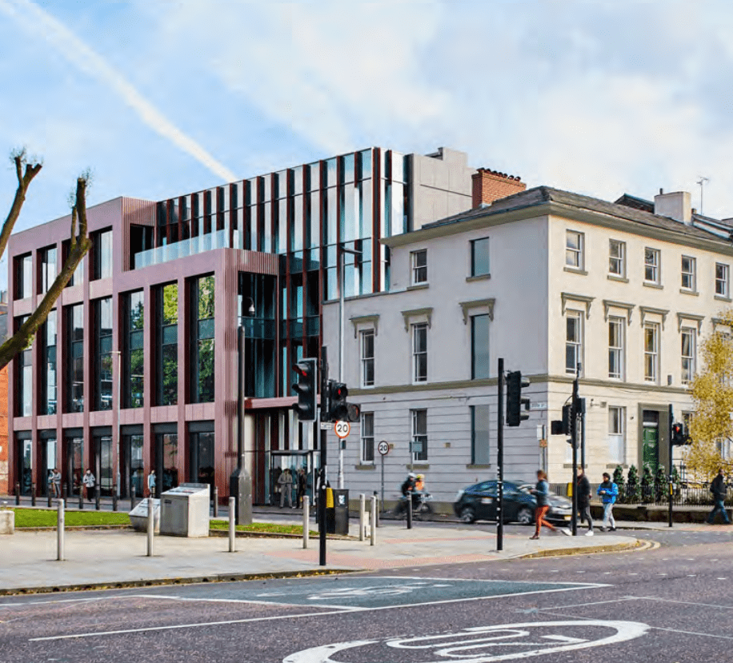
questions & further details
The Pankhurst Institute
Come and spend time working with us directly in our new home on Oxford Rd.
Sing-up for our newsletter
http://www.digital-solutions.uk/
@NERCdsh @gisplanner

