Slide 1
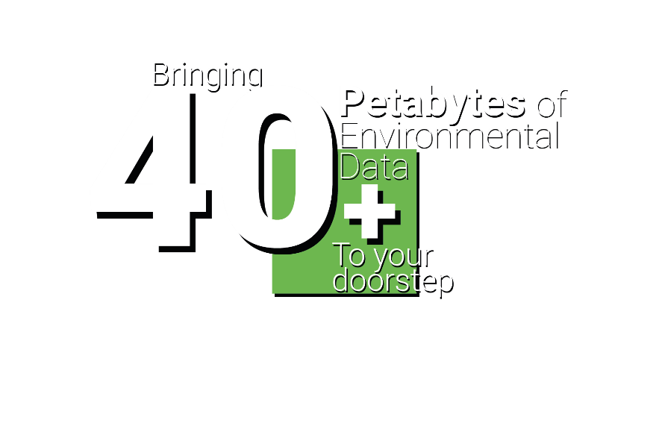
What users want & the challenges they face accessing environmental data: insights from user needs workshops
DIGITAL SOLUTIONS HUB
Nourhan Heysham, Richard Kingston, Dave Topping
digital-solutions.uk
@nercdsh

Slide 2
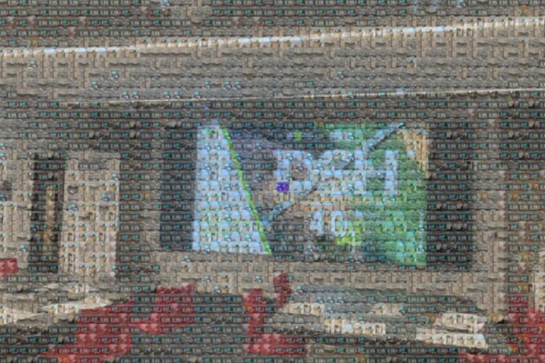
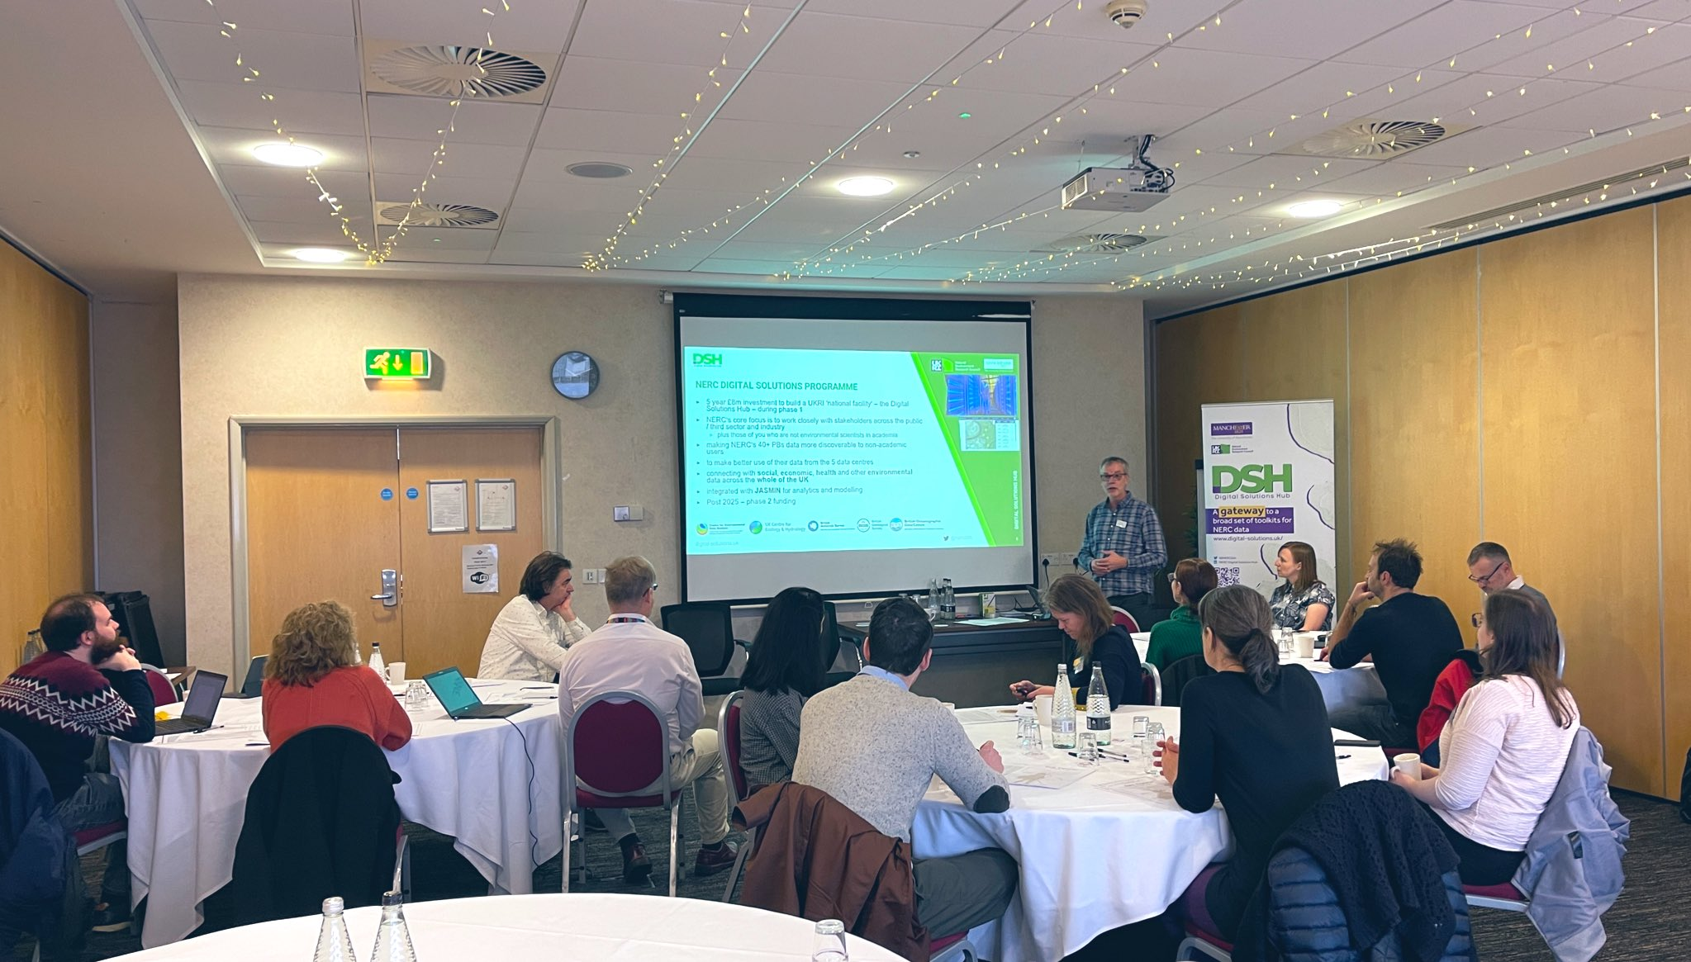
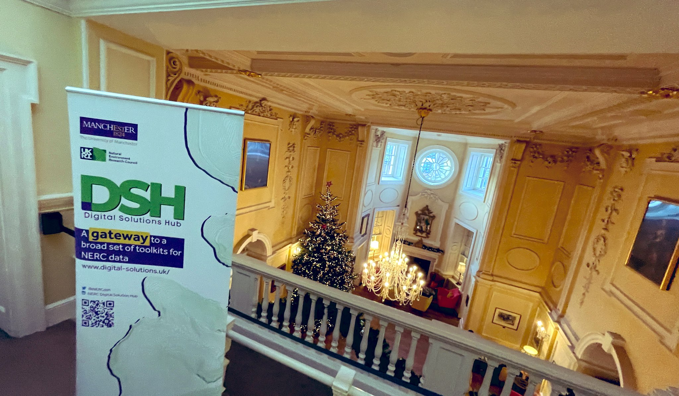
Abstract
This presentation highlights findings from user research conducted over a 3-month period. The aim was to discover who potential users are and their needs, gathered through in person and online workshops across the UK with over 100 people with an interest in using environmental data.
To make the DSH a success, it’s important to start by understanding who the potential users of the Hub are and what their needs are. For the Hub to work well, it cannot be just a stand-alone product, but must sit within a community of people who are aware of it, use it, and help shape its development.
Our approach was designed to also help develop this community – raising awareness of the Hub and forming links with potential users who could shape its ongoing development.
The workshops focused on participants’ experiences of utilising environmental data in their current job roles and the challenges that come with its use.
This was then used as a basis to discuss potential solutions and future developments. Some of the main outputs from this work include:
set of user stories describing the needs of users throughout their journey of using environmental data. These provide an overview of the needs found across those we spoke with, as well as the challenges currently faced with fulfilling these needs.
set of user archetypes that provide a way of thinking about the different users of the hub. These describe what different users are setting out to achieve, what steps they go through to achieve these, and important challenges faced by these groups.

Slide 3
User Needs Mapping Approach

Slide 4
User Needs to Design Decisions
Data Collection
Questions
Analysis
Output
User Needs Workshops
Who are the users?
ODM report
Personas
What (env.) data & tools do they use?
Network Analysis
Data & tools users need
How do they use (env.) data in their workflow?
ODM report
User Journeys / Scenarios
How can DSH improve their workflow?
Requirements Elicitation
Design Requirements

Slide 5
The Landscape Users Operate in
Data is held in lots of places.
Data is not always held in formats, or on systems, that make it easy to search for.
It’s not always obvious what the purpose of different platforms is, and the variety of data they contain.
It is hard to keep up with the ‘sheer range’ of these.
Some platforms are ‘clunky’ to learn and use with multiple clicks needed to get at data, or arduous registration processes.

Slide 6
Key Requirements
Users need sufficient access to the data to quality assure it, clean it and transform it into suitable format.
Reviewing a sample of a dataset may help determine its suitability in an easier way.
Users need to be able to keep track of work and resources they have done on datasets.
Users are keen to avoid duplication of effort – through sharing work they’ve done on datasets and accessing the work others have done.
A way of applying suitable analysis software to data.
Allow users to combine/link their own data with other data they access from DSH as part of analysis.
Notes:
Report about to be published with all the details

Slide 7
User Journey
Prioritise
Understand
Verify
Access
Test
Present
Iterate
Gather
Comprehend
Find
Promote
Process
Manage
Analyse
DEFINE
GET
ANALYSE
SHOWCASE
MANAGE

Slide 8
Archetypes (personas)
The
The
Analyst
Investigator
Analysts monitoring the environment
Analysts answering questions with data
The
The Data
Author
Specialist
Authors of monitoring frameworks
GIS specialists and data support
The Data
The Data
Leader
Steward
Data leaders in organisations
Focusing on data quality and sharing

Slide 9
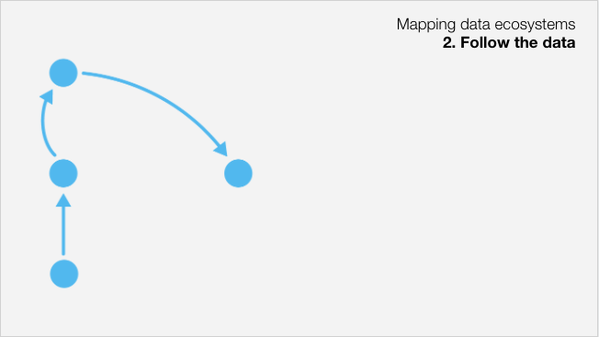
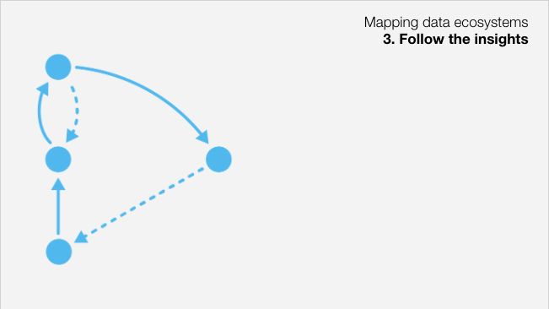
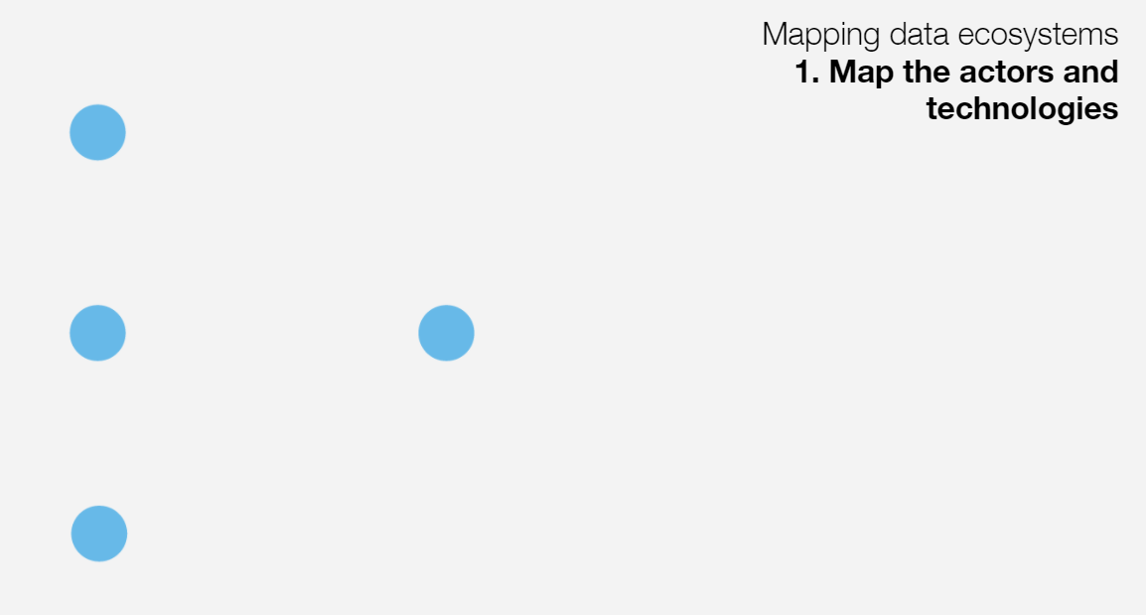
Network Analysis Approach
https://open-data-institute.gitbook.io/data-landscape-playbook/play-two-map-the-data-ecosystem/create-an-ecosystem-map

Slide 10
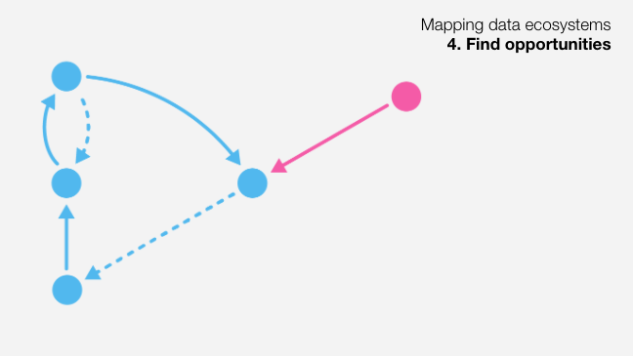
Network Analysis Approach
Insights on:
Noted Caveat:
This mapping represents patterns based on information declared by participants/users. Additional insights patterns might be present even if not mapped in this dataset.
Insights of existing patterns of use of environmental data
Opportunities for use cases within DSH
Opportunities for links between data providers and data consumers
INTERACTIVE DATASET
273 data transactions
100 users
84 organisations
Gaps of data use that can be addressed
https://open-data-institute.gitbook.io/data-landscape-playbook/play-two-map-the-data-ecosystem/create-an-ecosystem-map

Slide 11
Network Analysis Approach
User community
Units / Nodes
User
Users
Organisations (user affiliation/umbrellas)
User communities (un-affiliated)
c
Org 1
Org 2
d
User 1.2
Bond/Tie
b
User 1.1
b
Data as currency
a Raw data (primary)
b Processed data
c Analysed data / use case
d Tool / service / consultations
User 2.1
a
Full process (primary data collection + processing + analysis + sharing)
Data analysis and reporting process (processing + analysis + sharing)
Notes:
The network consists of:
Nodes – representing users and their affiliate organisations
Bonds/ties (arrows) – representing the interaction/currency, which is the data for this network.
Re: types of bonds/ties: each arrow “carries” attributes that describe this interaction between two nodes. The mapped attributes here are:
Which datasets are communicated from source to target nodes
Whether there has been any data transformation (i.e. is the data: a. Raw, b. being processed, c. being analysed, or d. the interaction is an exchange of information/service such as consulting colleagues/experts)

Slide 12
Data Network Analysis
Tracing the transfer and transformation of the data through different stakeholders through viewing user interactions with the data as a network map of data provision and manipulation, and the processing that takes place from raw data to sharable information.
Data here is treated as a 'bond' between source and target users/organisations, where the type of link depends on the type of use of data.
An interactive dataset on PowerBi, for DSH team to filter down data use by use case.
Central Gov
Private Sector
Charity / NGO
Local Gov
Research Facility
EU
Quango
Data recipients
Data source
Global

Slide 13
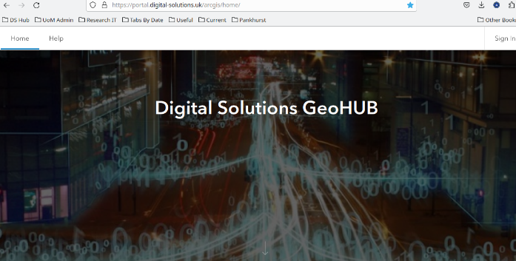
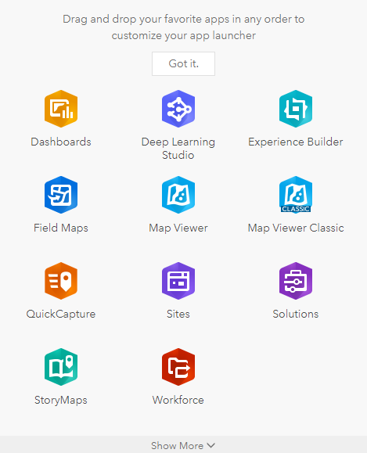
Next steps
Following up with workshop attendees (interviews and focus groups).
Developing detailed use cases.
Continue to build the Hub (on premise at UoM and on JASMIN) based on Esri’s ArcGIS Enterprise.
Provide early access to workshop attendees and other (you?) interested stakeholders.
Develop analytical tools for users.
A full report on the user engagement workshops will be published on our website by the end of this month.
Sign up for our newsletter to keep up to date via our website.

Slide 14
Connect with us
Thank you to NERC, our workshop stakeholders and the rest of the DSH team at home in Manchester

